Slide 1
Types of ML and Aspects of Successful ML Problems
Machine Learning through Application
Module 1 – Lesson 2

Slide 2
Today’s activities
Data in ML: The three most commonly used types
Types of ML
Supervised learning
Unsupervised learning
Aspects of successful ML problems
Applying MLDQs to some use cases

Slide 3

Three major components to ML
​Data
ML requires large amounts of data.
Data requires a lot of preparation.
​Compute
ML requires a lot of processing power.
Modern ML uses hardware acceleration (such as with GPUs) and parallelization.
​Algorithms
ML uses specialized frameworks and libraries, as well as innovative techniques, which are constantly improving.
Notes:
~Alt text for callout: Callout to indicate that today's focus is data.
~
The ability of ML algorithms to extract knowledge and insights from data with little programming effort—and faster and better than humans can—explains why ML is so popular.
To learn from experience, ML algorithms require a lot of experience—that is, a lot of data. For example, to use ML to handle more-complex tasks, such as face recognition, you need huge amounts of data to train the models on. However, data is plentiful now—it is easier to produce, collect, store, manipulate, and analyze than ever before.
Having a lot of data means that you need a lot of compute power to process the data, perform computations, examine the data with algorithmic steps, learn quickly, store the trained models, and make fast predictions. Compute power is available in many hardware architectures that are built for speed and efficiency.
Finally, you need fast and efficient algorithms to handle increasing amounts of data and effectively use the available compute resources.

Slide 4
Data in ML: The three most commonly used types

Slide 5
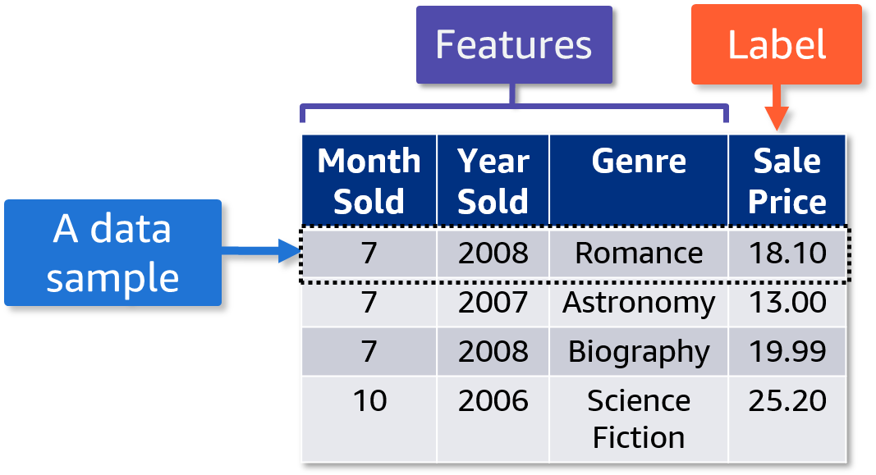
Review: Tabular data features and labels
Rows represent each data sample.
Columns represent each feature and the label.
Notes:
~Dev note: Graphic marked as decorative because it is described in the slide notes.
~
When tabular data is used in ML, the rows of the table represent each data sample. The columns represent each feature and the label.
In this table, the features include Month Sold, Year Sold, and Genre, while the label is the Sale Price. Each row is a data sample.

Slide 6
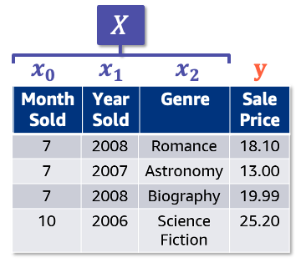
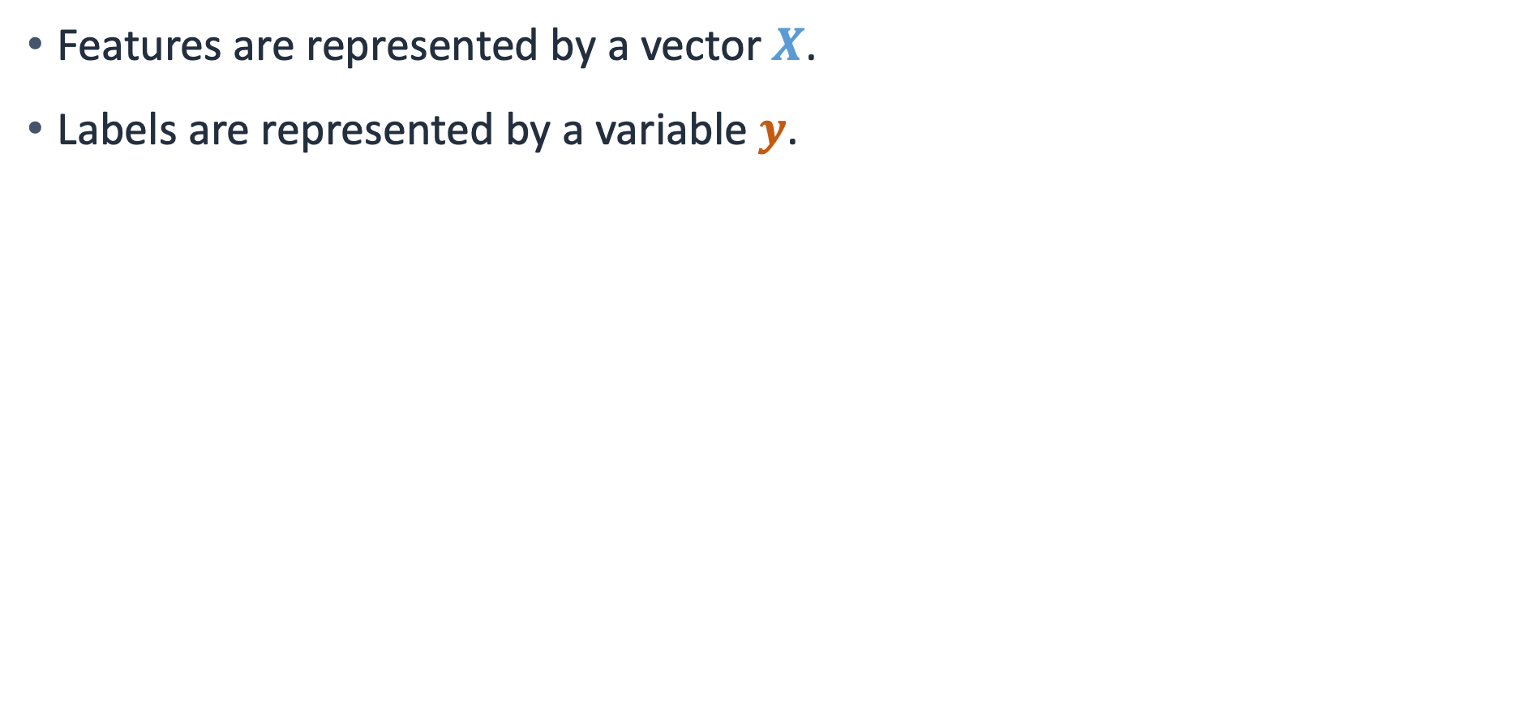
Review: Tabular data vectors and variables
Features are represented by a vector $X$.
Labels are represented by a variable $y$.
Notes:
~Equation text
~Alt text: Table from previous slide. First three columns are features, and fourth column is the label.
~
In tabular data, features are represented by a vector X. Labels are represented by a variable y.

Slide 7
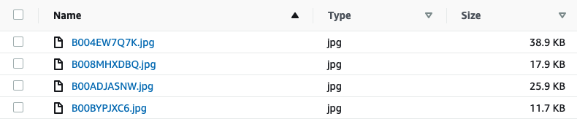
Image data: Features and labels
Each data sample is an image that is stored as a file.
Features are determined by pixels and their relationships to each other.
Example label: What kind of animal is in the image?
Example of an image dataset
Notes:
~Alt text: List of JPG files with their size included.
~
Another of the most commonly used types of data in ML is image data.

Slide 8

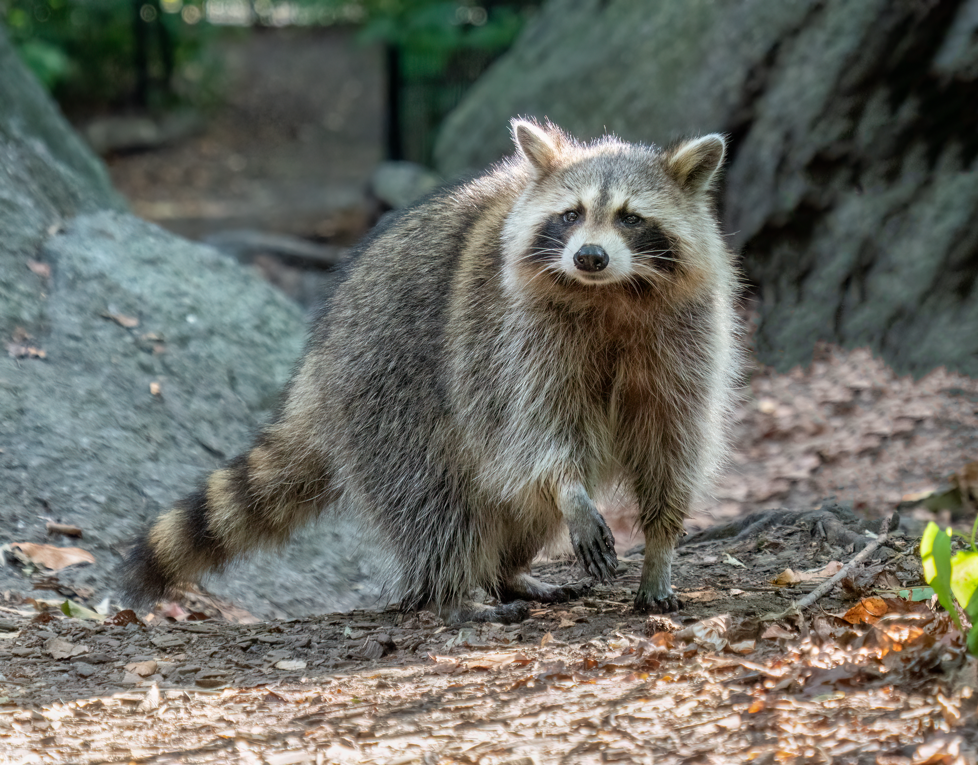

Example of features and labels in image data
Provide many images that are labeled as raccoons
To know whether an image is of a raccoon…
Raccoon
The algorithm treats the raccoon’s pixels as features and uses them to train the model
Racoon
Notes:
~Alt text – bottom-left raccoon image: Racoon walking on ground.
~Alt text – top center raccoon image: Raccoon in tree labeled as raccoon.
~Alt text – bottom-right raccoon image: Marked as decorative.
Image attribution: Rhododendrites/CC BY-SA 4.0 (https://creativecommons.org/licenses/by-sa/4.0/): https://commons.wikimedia.org/wiki/File:Raccoon_in_Central_Park_(35264).jpg
Image attribution: Clément Bardot/CC BY-SA 4.0 (https://creativecommons.org/licenses/by-sa/4.0/): https://commons.wikimedia.org/wiki/File:Raton_laveur_commun_(Procyon_lotor).jpg

Slide 9
Text data: Features and labels
Each data sample is a piece of text that is stored as a file. For example, a data sample might be a sentence, chapter, or document.
Features are text characters or words.
Example label: Does the text express a positive sentiment or a negative sentiment?
Example of a text dataset
“This book is pretty good! I would recommend it to my friends.”
Notes:
The last type of data that is commonly used in ML is text data.

Slide 10
Example of features and labels in text data
“This”, “book”, “is”, “pretty”, “good”, “I”, “would”, “recommend”, “it”, “to”, “my”, “friends”
Use the words as features to train the model
To know whether this is a positive review…
“This book is pretty good! I would recommend it to my friends.”
Sentiment: “positive”
Along with the label: sentiment = “positive”

Slide 11
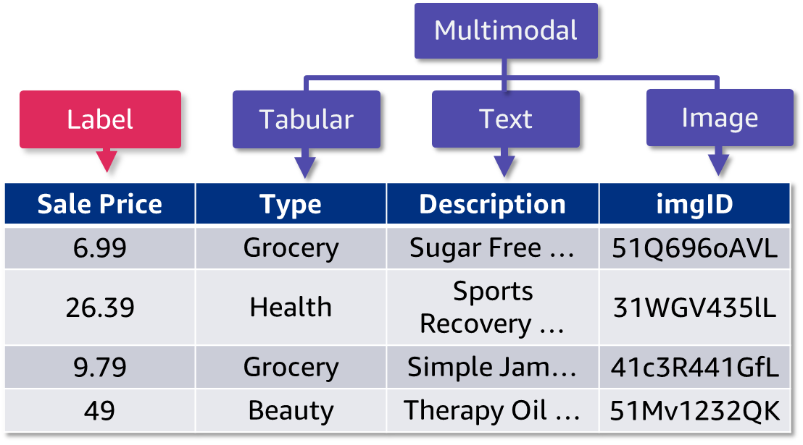
Multimodal data: Features and labels
Multimodal: Combination of data types (tabular, text, and image)
Label: Categorical values (such as purchase category) or numerical values (such as sale price, showed in the picture)
Notes:
~Alt text: Table with callouts to identify features and labels. See details in notes.
~
Image description: Table with four columns: Sale Price, Type, Description, and imgID. A callout indicates that Sale Price is the label. The Type column includes data such as grocery, health, and beauty. This is noted as tabular data. The Description column includes text phrases that describe items, and this column is noted as text data. The imgID column includes a unique ID for an item’s image, and this column is noted as image data. The columns with three different data types are grouped together under a callout that is labeled multimodal. End description.
When you combine types of data, the data is referred to as multimodal data.

Slide 12
Types of ML

Slide 13
Comparing supervised and unsupervised learning
Supervised learning
Unsupervised learning
Data is provided with labels.
The model learns by looking at these examples.
Data is provided without labels.
The model finds patterns in the data.
Notes:
Another interesting thing about ML is the variety of algorithms. Sometimes, multiple algorithms are available to solve the same type of problem.
While certain algorithms perform better than others with certain types of data, no single algorithm outperforms all others on all problems. This concept is called the no-free-lunch theorem.
For a given task or problem, choose a few algorithms that are known to work well for that type of data and problem. Then, select the best-performing one.
Narrow down the initial choices by dividing the ML algorithms into categories that are based on the task that they perform and how they perform it.
Two main categories are: supervised and unsupervised learning.
Supervised learning uses labeled datasets, whereas unsupervised learning uses unlabeled datasets. By “labeled” we mean that the data is already tagged with the right answer.

Slide 14
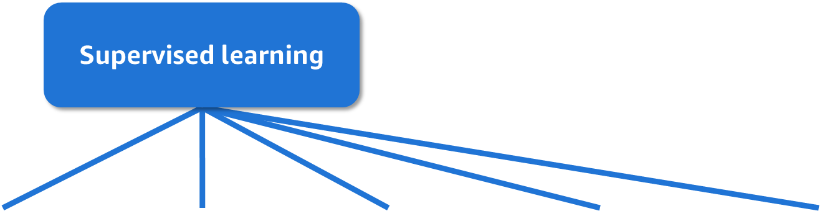
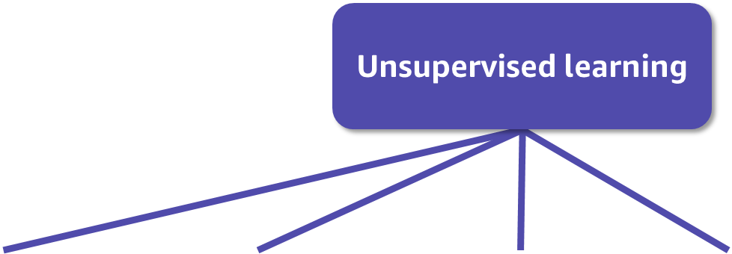
Types of ML problems
Regression
Classification
Ranking
Recommendation
Anomaly detection
Clustering
Predicting a numerical value
Predicting a label
Ordering items to find the most relevant
Finding relevant items based on past behavior
Finding outliers from examples
Finding patterns in examples
Notes:
~Alt text – Supervised learning: Supervised learning connects to regression, classification, ranking, recommendation, and anomaly detection.
~Alt text – Unsupervised learning: Unsupervised learning connects to ranking, recommendation, anomaly detection, and clustering.
~
Regression is used to predict a numerical value, such as predicting a house price. Classification is used to predict a label, such as determining whether a specific person is in a picture. Ranking is used to order items by the most relevant.
Recommendation is used to find relevant items, based on past behavior. Anomaly detection is used to find outliers from examples in data. Clustering is used to find patterns in examples.
Supervised learning is commonly used for regression, classification, ranking, recommendation, and anomaly detection problems. Unsupervised learning is commonly used for ranking, recommendation, anomaly detection, and clustering problems.
This lesson will focus on three types of problems: regression, classification, and clustering.

Slide 15
Three commonly used types of problems
Supervised learning
Unsupervised learning
Regression
Classification
Clustering
Example: Predict book prices
Example: Predict book genres
Example: Identify fraudulent listings for books
Notes:
Boundaries are not always clear for problem types and learning types; however, classification and regression are forms of supervised learning. Examples include predicting book prices, as an example of regression, and predicting book genres, as an example of classification.
Clustering is a form of unsupervised learning. An example is identifying fraudulent listings.

Slide 16
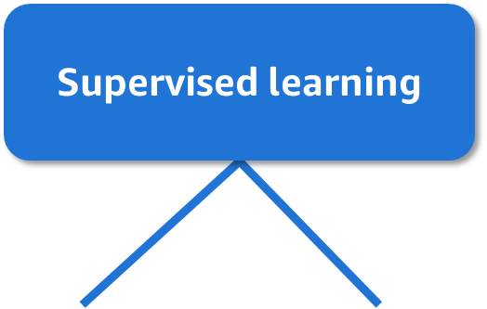
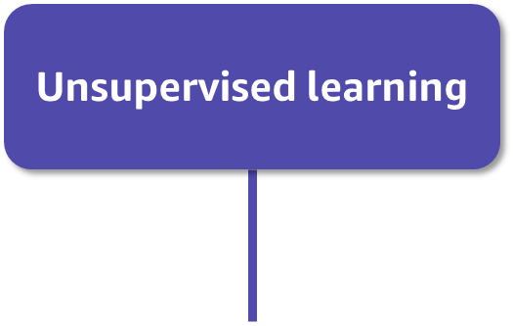
Commonly used ML algorithms
Regression
Classification
Clustering
Examples:
Linear regression
K-nearest neighbors (KNN)
Neural networks
Decision trees
Examples:
Decision trees
Logistic Regression
Support vector machines
KNN
Neural networks
Examples:
K-means
Principal component analysis (PCA)
Collaborative filtering
Notes:
In this course, you will learn about linear regression, decision trees, and K-means algorithms.

Slide 17
Supervised learning

Slide 18
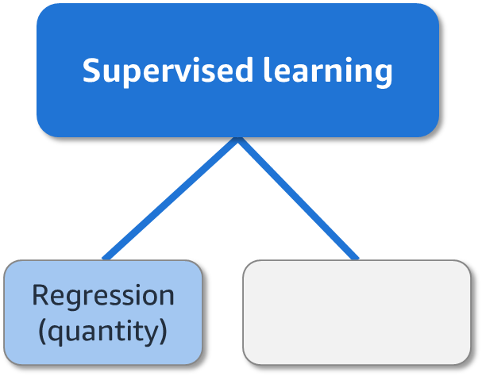
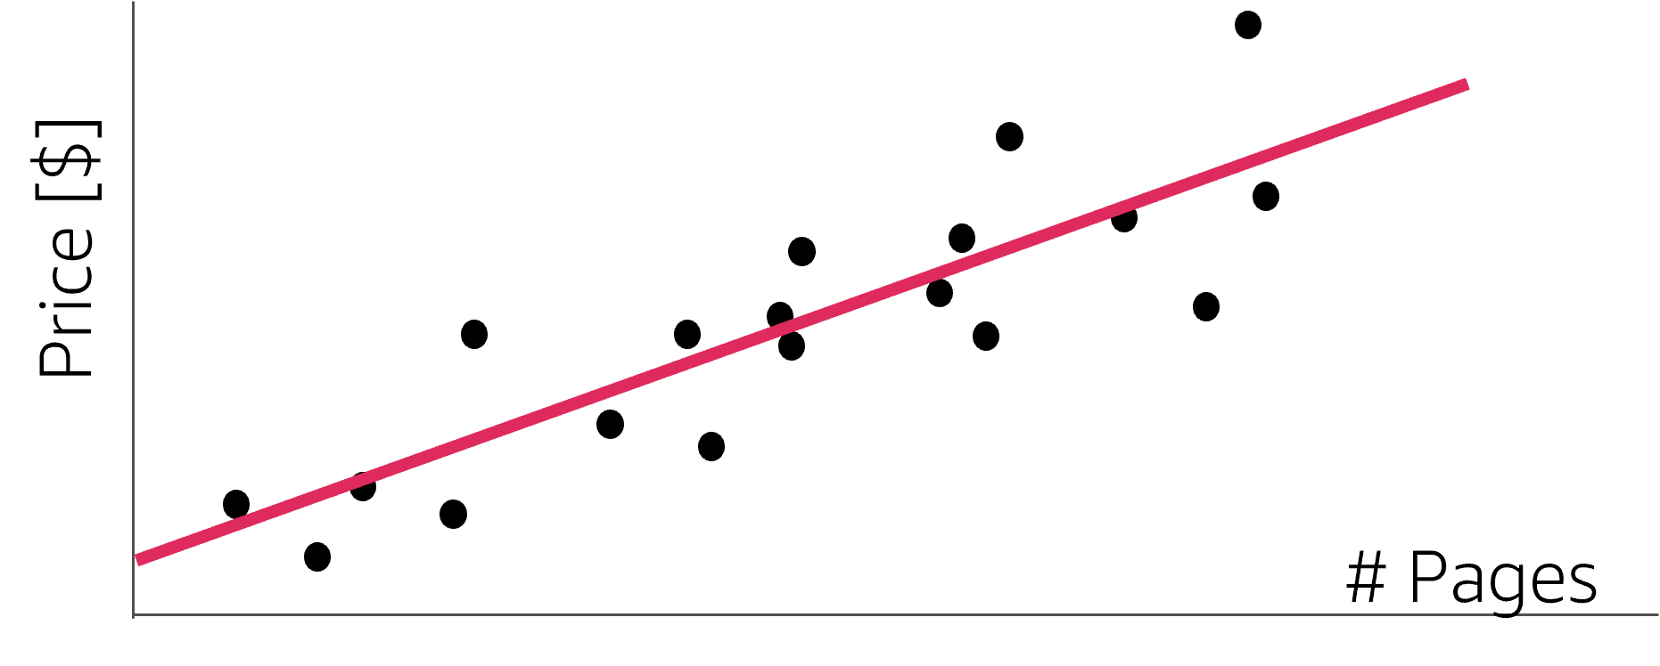
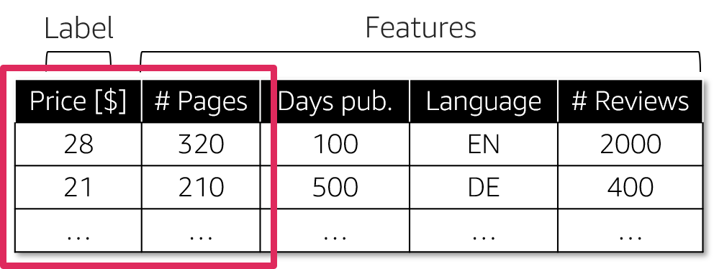
Supervised learning: Regression
Example:
Linear regression
Notes:
~Alt text – scatter plot: Scatterplot of data points with a line of best fit. See details in notes.
~Alt text – table: Table related to the scatterplot. See detail in notes.
~Alt text – supervised learning: Regression (quantity).
~
Image 1 description: Scatterplot of data points with a line of best fit. Price is the y axis, and number of pages is the x axis. The line slopes from lower price and fewer pages in the bottom-left corner toward higher price and more pages in the upper-right corner. End description.
Image 2 description: Table with five columns: price, number of pages, days published, language, and number of reviews. Price is noted as the label. The remaining columns are marked as features. Price and number of pages are circled to indicate that the data points on the scatterplot are based on these columns. End description.
Regression is a popular type of supervised learning problem. Regression aims to learn relationships and correlations between input features and a continuous output variable, with the goal to predict the continuous output variable. For example, the price of a book might depend on a certain combination of the number of pages, days since being published, and language.
The slide shows a simple linear regression model. If you assume that the relationship between the sale price of a book and the number of pages is linear (in other words, as the number of pages increases, the price of the book increases), the line of best fit is a straight line.
Some ML algorithms that you can use to build regression models include linear regression, K-nearest neighbors (KNN), decision trees, and neural networks (NN).

Slide 19
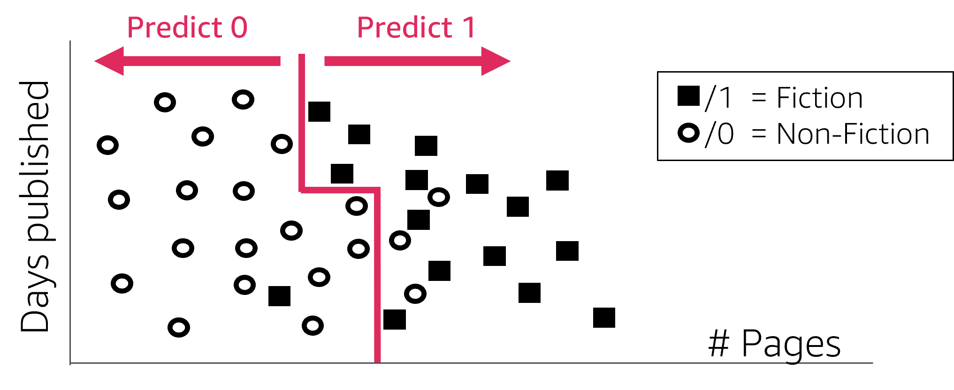
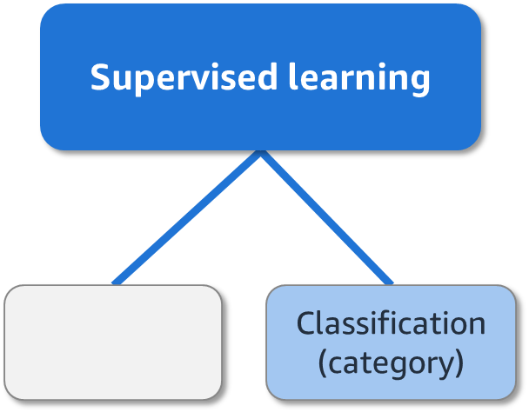
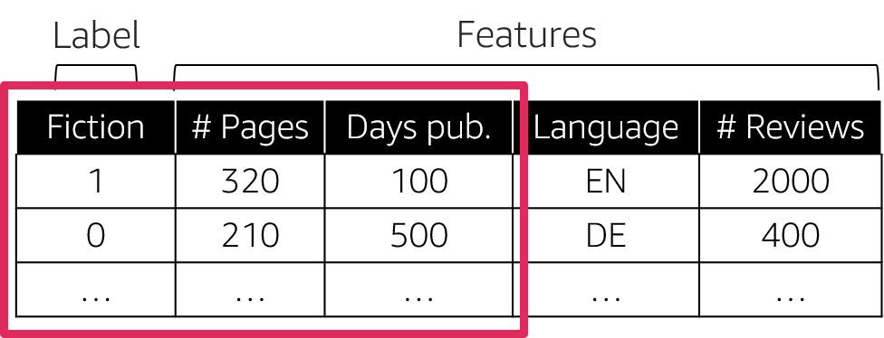
Supervised learning: Classification
Example:
Decision trees
Notes:
~Alt text – chart: Scatterplot with a mix of circles and squares. See details in notes.
~Alt text – supervised learning: Classification (category).
~Alt text – table: Table with five columns related to the scatterplot. See detail in notes.
~
Image 1 description: Scatterplot with a mix of circles and squares. Days published is the y axis, and number of pages is the x axis. The circles represent nonfiction, and the squares represent fiction. The data is divided into multiple rectangular regions that represent each category. The left region is mostly circles, and the right region is mostly squares. The regions represent the way the model classifies data in this dataset. End description.
Image 2 description: A table with five columns. Fiction, number of pages, days pub., language, and number of reviews. Fiction is noted as the label, and the values in the fiction column are 0 for non-fiction or 1 for fiction. The remaining columns are marked as features. Fiction, number of pages, and days pub are circled to show that the data on the scatterplot is based on these three columns. End description.
If you’d rather know whether a particular book is fiction or nonfiction, that would be a classification problem. Classification aims to learn the relationships between input features and an output variable, with the scope of separating the data into classes or groups.
The main difference between regression and classification is that the output variable in regression is numerical (or continuous), while the output variable for classification is categorical (or discrete).
The example on the slide shows a binary classification scenario—that is, there are only two classes.
Some ML algorithms that you can use to build classification models are logistic regression, support vector machines, KNN, decision trees, and neural networks.

Slide 20
Unsupervised learning

Slide 21
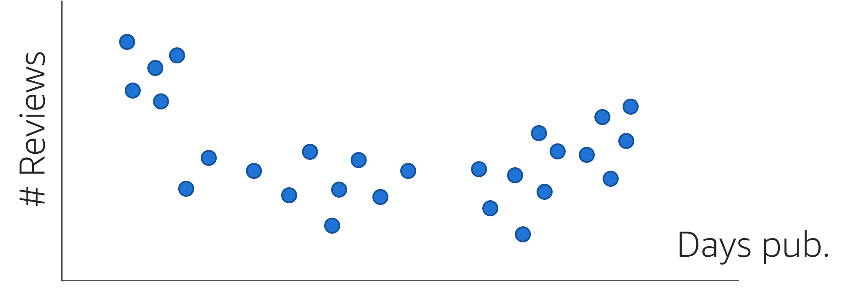
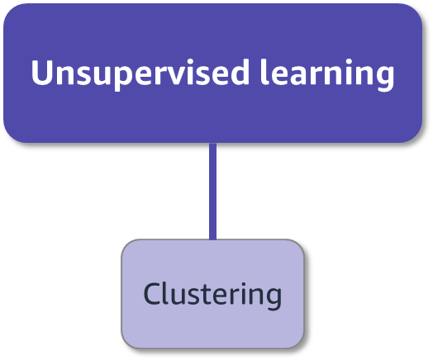
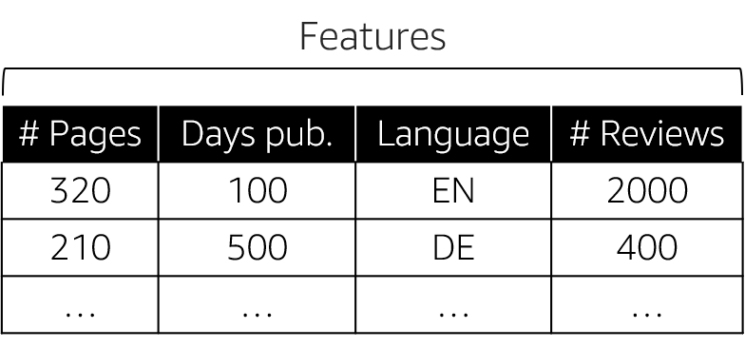
Unsupervised learning: Clustering
Notes:
~Alt text – scatterplot: Scatterplot with clusters of dots. Detail in notes.
~Alt text – table: Table with five columns related to the scatterplot. Detail in notes.
~Alt text – Unsupervised learning/clustering: Marked as decorative.
~
Image 1 description: A scatterplot. The y-axis is number of reviews and the x-axis is days pub. There are clusters of data points and they are all blue circles. End description
Image 2 description: A table with four columns: number of pages, days pub., language, and number of reviews. All four columns are categorized as features. End description.
One example of unsupervised learning is clustering. Clustering involves grouping unlabeled data points according to their features. For example, clustering can be used in market segmentation to try to find customers that are similar to each other in terms of behaviors or attributes. Feature 1 could be age, and feature 2 could be the type of music that customers listen to.
A visual overview of the data sometimes doesn’t suggest an obvious choice for the number of clusters. It can also be difficult to visualize data in general, especially if you use more than four features. If you don’t see or have prior information about how many clusters there are, or if you don’t have a request to produce a specified number of clusters, the challenge is to determine how many clusters to extract. This becomes a judgment call.
Metrics can help to guide decision-making. However, the most important goal is clusters that make sense and meet the objective; for example, identifying as distinct as possible customers clusters for the business.

Slide 22
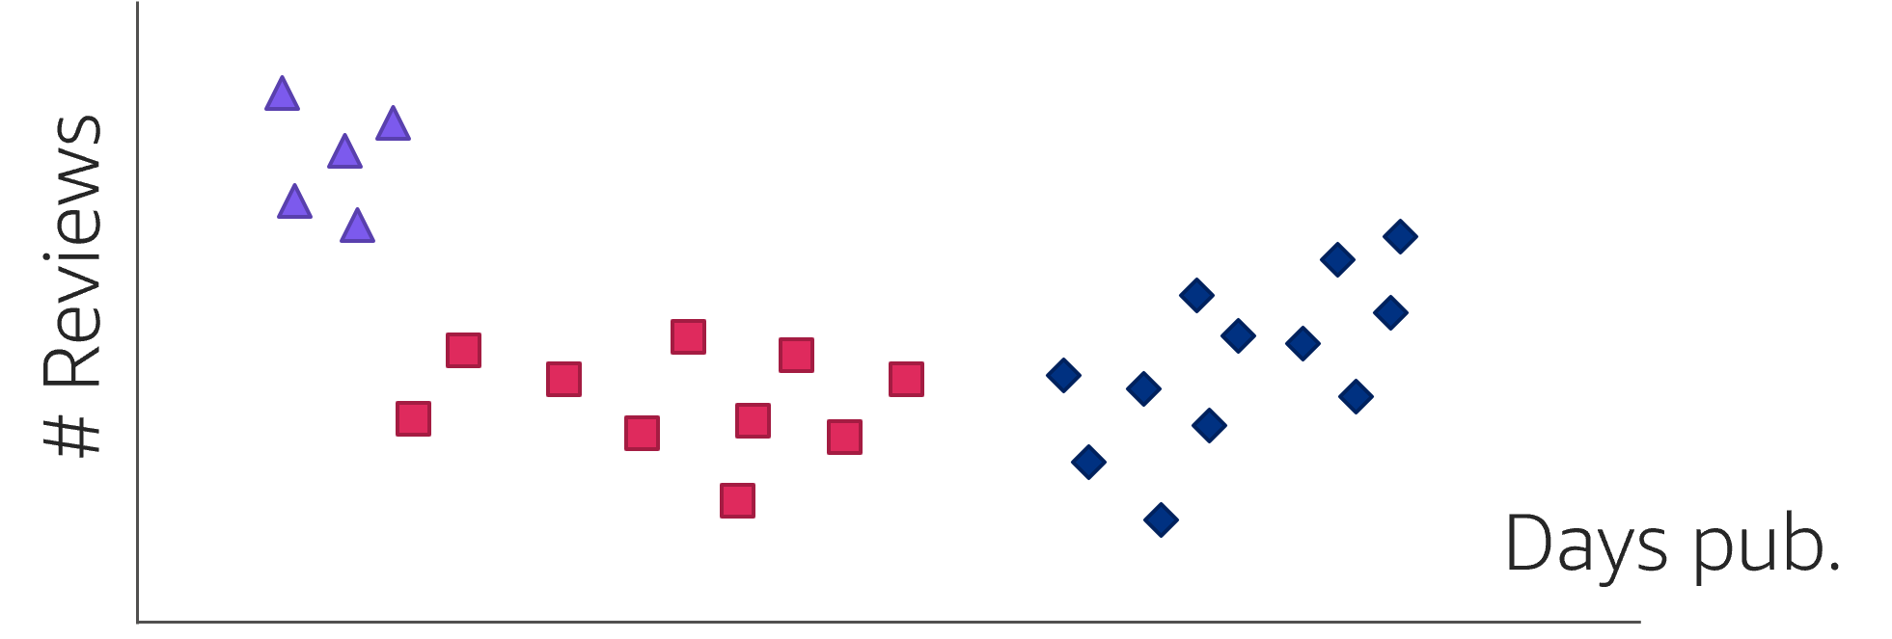
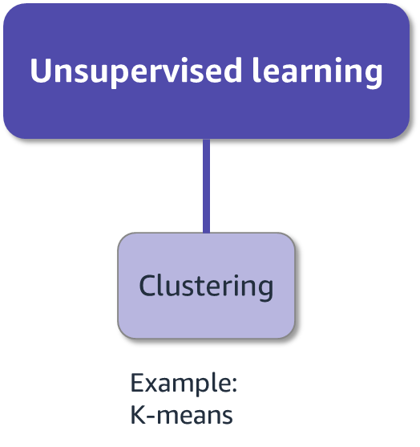
Clustering example: K-means
Notes:
~Alt text – plot: Scatterplot from previous slide but three clusters are represented with separate icons.
~Alt text – table: Same data table from the previous slide.
~Alt text – Unsupervised learning/clustering: Marked as decorative.
~
The most common type of clustering is called K-means clustering. K-means clustering involves first selecting K (the number of desired clusters) and then partitioning the data into these K clusters, such that data points in each cluster are as similar as possible.
One outcome for the market segmentation problem is shown here for K = 3. During model training, the K-means algorithm uses the distances from data points to three possible centroids to assign the data points to the closest cluster centroid.

Slide 23
Review of ML vocabulary
Label = Output that you are trying to predict
Feature = Data input to help you make predictions
Supervised learning
Tries to predict a specific label (such as quantity) by using features
Requires training data with labels
Can directly measure model performance
Unsupervised learning
Looks for structure or unusual patterns to understand the data
Doesn’t use labeled data
Usually provides an indirect evaluation (because something specific isn’t predicted)

Slide 24
Aspects of successful ML problems

Slide 25
How do you know if ML is suitable for your problem?
Not all problems are suitable for ML.

Slide 26

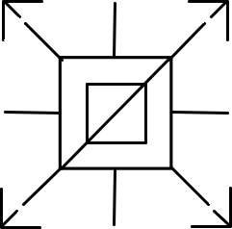

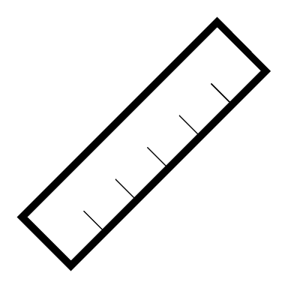
Indicators that ML might be a suitable choice
Has high complexity
Needs scalability
Needs adaptability and responsiveness
Is specific and measurable
Notes:
When you encounter a problem, it is important to start by evaluating whether the problem is a good fit to be solved with ML. The indicators on this slide can help you determine this. Note that a problem might not satisfy all of these indicators. However, if a problem doesn’t satisfy any of them, that problem might not be best solved with ML. The next slide will present indicators that can help you to know that ML is not a suitable choice for a particular problem.
First, the problem should require complex logic. If the task can be solved easily with a few hand-coded rules, or simple heuristics work well enough for the business case, don’t take on the additional complexity of ML. ML will probably not be worth the investment. This point can be subtle because many problems are complex, such as supply chain optimization problems, which are already optimally solved by existing efficient and scalable algorithms.
Second, if scalability is a challenge, that is a strong indicator that ML could help. If a task normally requires human action but you want to perform the task millions or billions of times, training an ML model to perform that task and then deploying it at scale is a good solution.
Third, if you need to make predictions for unseen data, you need ML, especially if you need the system to be more responsive than a human could be. If a task normally requires human reasoning, but you need the task to be done in less than a tenth of a second, ML is often an excellent solution. Examples include face detection for autofocus on cameras or automated content moderation on a social media platform.
The final indicator is that the problem is specific and measurable with a real business goal in mind.

Slide 27


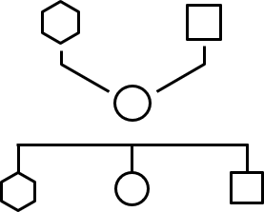
Indicators that ML is not a suitable choice
Traditional algorithms would work
You require 100 percent accuracy
You require full interpretability
Notes:
Conversely, indicators can also help you determine if ML cannot be successfully applied for a problem. If a problem fits one of these indicators, it doesn’t mean that you cannot use ML. However, the indicator might inform choices that you need to make during the development process or might lead to an extended timeline for development.
First, as stated previously, if the problem can be solved with existing efficient algorithms, ML will not provide a benefit.
If the problem requires 100 percent accuracy, you should not use ML. ML is inherently about estimation and cannot provide guarantees of perfect accuracy.
Finally, if interpretability is required, then that limits the types of ML that you can apply to a problem. Unlike a human, you cannot ask the algorithm how it decided. The majority of the most powerful ML models are black-box models that produce results without indicating why. The reason such powerful models are considered as black-boxes is because they lack interpretability related to why a particular prediction was made.

Slide 28
MLDQs
ML decision questions (MLDQs): A set of questions that guide you through the ML lifecycle

Slide 29
Example MLDQs
What makes this problem suitable for ML?
What business goal can be achieved by building an ML solution to address this problem?
What kind of ML model (regression, classification, or clustering) can solve this problem?
What data might be necessary to address this problem? Is the data already available and relevant?
How accurate (good) does the model need to be?

Slide 30
Applying MLDQs to some use cases
Notes:
In this section, you are going to walk through some example use cases and determining whether ML is a good fit.

Slide 31
Use case 1: Backfilling missing attributes
For many products in an ecommerce catalog, attributes (for example, color or size) are missing or incorrect. You can lose customer trust when product results don’t match what a customer is looking for. You can lose sales when products have been labeled incorrectly or aren’t discoverable.
You are asked to build ML models that can predict attributes (such as color) from product images. You can use those models to predict and backfill the color attribute in the catalog.
Notes:
The key phrases of this use case are missing or incorrect attributes and building ML models that can predict attributes from project images.

Slide 32
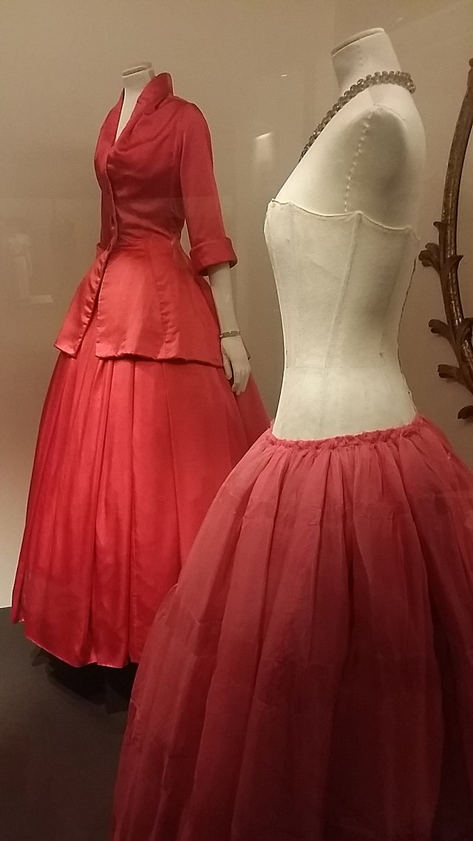
When color is missing
Color | Confidence Score
red | 0.80
pink | 0.10
orange | 0.04
purple | 0.03
brown | 0.02
black | 0.01
Notes:
~Alt text – picture: Red dresses on mannequins.
~
The company could deploy several types of ML models to predict different attributes (such as color and style).
For example, the color attribute information for a dress might be missing or incorrect. The company could lose customer trust if the dress doesn’t match the customer’s search criteria, and lose sales if the dress was labeled incorrectly or if the dress isn’t discoverable. Also, the dress might not appear in the results if the customer filters on color.
You were asked to build ML models that can predict the color information from this dress image. After training with many images, you can use the trained model to predict and backfill the color attribute in the catalog.
The table shows the confidence score of each color for this dress. From the prediction result, you can conclude that the dress is red.
Image attribution: Mabalu/CC BY-SA 4.0 (https://creativecommons.org/licenses/by-sa/4.0/): https://commons.wikimedia.org/wiki/File:Christian_Dior_evening_gown_called_%22Z%C3%A9mire%22,_Fall-Winter_1954_01.jpg

Slide 33
Use case 1: MLDQ 1
What makes this problem suitable for ML?
Manual extraction and labeling of colors is not scalable. Simple rules that are based on pixel inspection won’t solve many real cases (for example, presence of a human model or large white background areas).

Slide 34
Use case 1: MLDQ 2
What business goal can be achieved by building an ML solution to address this problem?
Customer trust: Complete and accurate product information across all marketplaces will provide a better shopping experience for customers, which will lead to higher customer trust and increased sales.

Slide 35
Use case 1: MLDQ 3
What kind of ML model (regression, classification, or clustering) can solve this problem?
Classification can be used. This problem requires multiclass classification (different candidate colors).

Slide 36
Use case 1: MLDQ 4
What data might be necessary to address this problem? Is the data already available and relevant?
To solve this problem, you need a dataset with images that have correspondent color labels. Some sellers might already provide color values for their products, but the values might not be accurate and might require additional verification.

Slide 37
Use case 1: MLDQ 5
How accurate (good) does the model need to be?
To keep the quality bar high, you can define thresholds for every class so that only confident predictions are published to the catalog (for example, with precision above 90 percent).

Slide 38
Use case 2: Sentiment analysis
Data from customer feedback (customer contacts, product reviews, and return messages) on an e-commerce website contains valuable information about users. Sentiment analysis would provide a unique window into the customer experience. By understanding text sentiment, the company could improve their products to better meet customers’ needs.
You are asked to build ML predictive models that can generate sentiment analysis scores for text data in customer feedback.
Notes:
The key phrases of this use case are data from customer feedback, sentiment analysis, and building ML predictive models that can generate sentiment analysis scores.

Slide 39
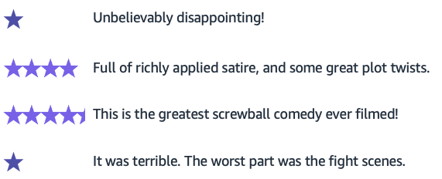
Star ratings for a movie
Notes:
~Alt text – 1 star 1st example: One star.
~Alt text – 4 stars: Four stars.
~Alt text – 4.5 stars: Four and a half stars.
~Alt text – 1 star 2nd example: One star.

Slide 40
Use case 2: MLDQ 1
What makes this problem suitable for ML?
Manual extraction of text sentiment at scale is impractical. Simple rules that are based on the presence of positive or negative words in a sentence will not solve many real cases (for example, nuanced language or mixed sentiments).

Slide 41
Use case 2: MLDQ 2
What business goal can be achieved by building an ML solution to address this problem?
Customer understanding: Knowing what users think and how they feel about products adds context to the raw text and enables prioritization. This process can also surface problems and customer dissatisfaction early.

Slide 42
Use case 2: MLDQ 3
What kind of ML model (regression, classification, or clustering) can solve this problem?
Regression can be used to predict star ratings based on text sentiment.
Notes:
Regression can be used to predict star rating because you can consider the model output as a numeric value (for example, 3 stars, 4.5 stars).

Slide 43
Use case 2: MLDQ 4
What data might be necessary to address this problem? Is the data already available and relevant?
To solve this, you need a dataset with text (customer contacts, product reviews, and return messages) with correspondent sentiment labels. Text data can be extracted from the voice of the customers. Human annotation of the data is required, which might be costly.

Slide 44
Use case 2: MLDQ 5
How accurate (good) does the model need to be?
Typically, classification accuracy will be used.
If you have multiple sentiment classes or an imbalanced number of samples in sentiment classes, you need to compute the balanced accuracy (assign weights to different sentiment classes) to identify the performance of the classifier toward the different labels.

Slide 45

Next lesson
How do you know how successful a model is?
What are some examples of ML applications?
See you next time!

Slide 47
Image source slide (for curriculum development use only)

Slide 48
Source graphic: Three major components to ML
Our focus today
Notes:
~Source for graphic on slide 3

Slide 49
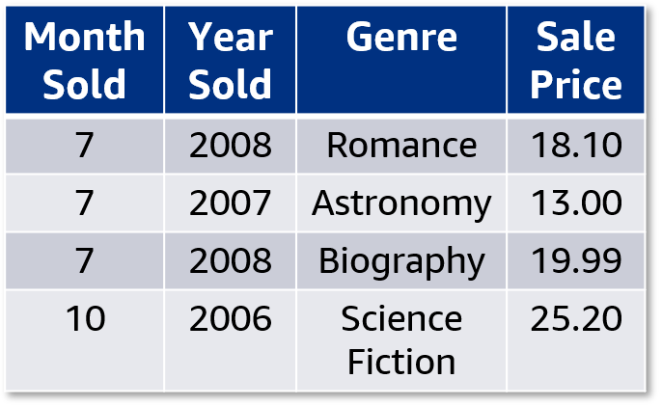
Source graphic: Review: Tabular data features and labels
Features
Label
A data sample
Notes:
~Source for slide 5

Slide 50

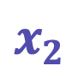
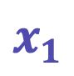


Source graphic: Review: Tabular data vectors and variables
$$X$$
$$x_{0}$$
$$x_{1}$$
$$x_{2}$$
$$y$$
Month Sold | Year Sold | Genre | Sale Price
7 | 2008 | Romance | 18.10
7 | 2007 | Astronomy | 13.00
7 | 2008 | Biography | 19.99
10 | 2006 | Science Fiction | 25.20
Notes:
~Source for slide 6

Slide 51
Source graphic: Multimodal Data: Features & Labels
Multimodal
Label
Tabular
Text
Image
Sale Price | Type | Description | imgID
6.99 | Grocery | Sugar Free … | 51Q696oAVL
26.39 | Health | Sports Recovery … | 31WGV435lL
9.79 | Grocery | Simple Jam… | 41c3R441GfL
49 | Beauty | Therapy Oil … | 51Mv1232QK
Notes:
~Source for slide 11

Slide 52
Source graphic: Types of machine learning problems
Supervised learning
Unsupervised learning
Regression
Classification
Ranking
Recommendation
Anomaly detection
Clustering
Notes:
~Source for slide 14

Slide 53
Source graphic: Supervised Learning: Regression
Supervised learning
Regression (quantity)
Label
Features
Price [$] | # Pages | Days pub. | Language | # Reviews
28 | 320 | 100 | EN | 2000
21 | 210 | 500 | DE | 400
… | … | … | … | …
Notes:
~Source for slide 18

Slide 54
Source graphic: Supervised Learning: Classification
Supervised learning
Classification (category)
Label
Features
Fiction | # Pages | Days pub. | Language | # Reviews
1 | 320 | 100 | EN | 2000
0 | 210 | 500 | DE | 400
… | … | … | … | …
Notes:
~Source for slide 19

Slide 55
Source graphic: Unsupervised learning: Clustering
Unsupervised learning
Clustering
Features
# Pages | Days pub. | Language | # Reviews
320 | 100 | EN | 2000
210 | 500 | DE | 400
… | … | … | …
Notes:
~Source for slide 21

Slide 56
Source graphic: Clustering example: K-means
Unsupervised learning
Clustering
Features
# Pages | Days pub. | Language | # Reviews
320 | 100 | EN | 2000
210 | 500 | DE | 400
… | … | … | …
Example:
K-means
Notes:
~Source for slide 22

